Slide 1

PatchNotes

Slide 2
Table of contents
01
02
03
04
05
06
What is PatchNotes?
User and Stakeholders
General Idea
Those who our application will benefit
Technologies
Requirements
Breakdown of our Stack and/or API’s
Functional and Non-Functional
Sitemap and Wireframes
Video!
Our pitch…
Notes:
Dan

Slide 3
What is PatchNotes?
Are you up to date with the constant government updates that are happening?
Perhaps you know about the TikTok ban…
PatchNotes will keep you updated with every updates released by the government
Being educated should not be a chore

Slide 4
Users/Stakeholders
Citizens and Residents
Healthcare, education, public services, etc. that affect our daily lives
Journalists and Media Outlets
Reliable source for real-time government updates
Simplify research by accessing concise summaries and links to official documents
Small Business owners
Be aware of any changes in business regulations, taxes, any economic policies, etc…
Notes:
Diego

Slide 5
Technologies
NodeJS
MongoDB
React
Web scrapers
Beautiful Soup
Scrapy
Legislation APIs
Open GSA
ProPublica Congress API
LegiScan
Notes:
JJ

Slide 6
Requirements
Functional:
Account registration and login with email and password.
Pull news from official ‘.gov’ sources.
Search and filter through our data
Non-Functional
Automatic data collection and site updates
Monitor our data sources
Mobile responsiveness

Slide 7
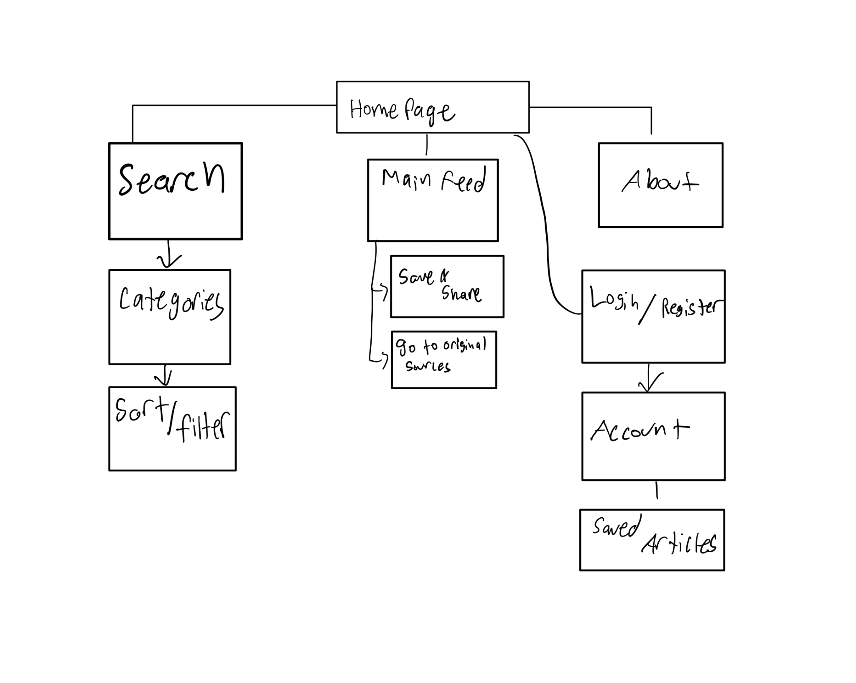
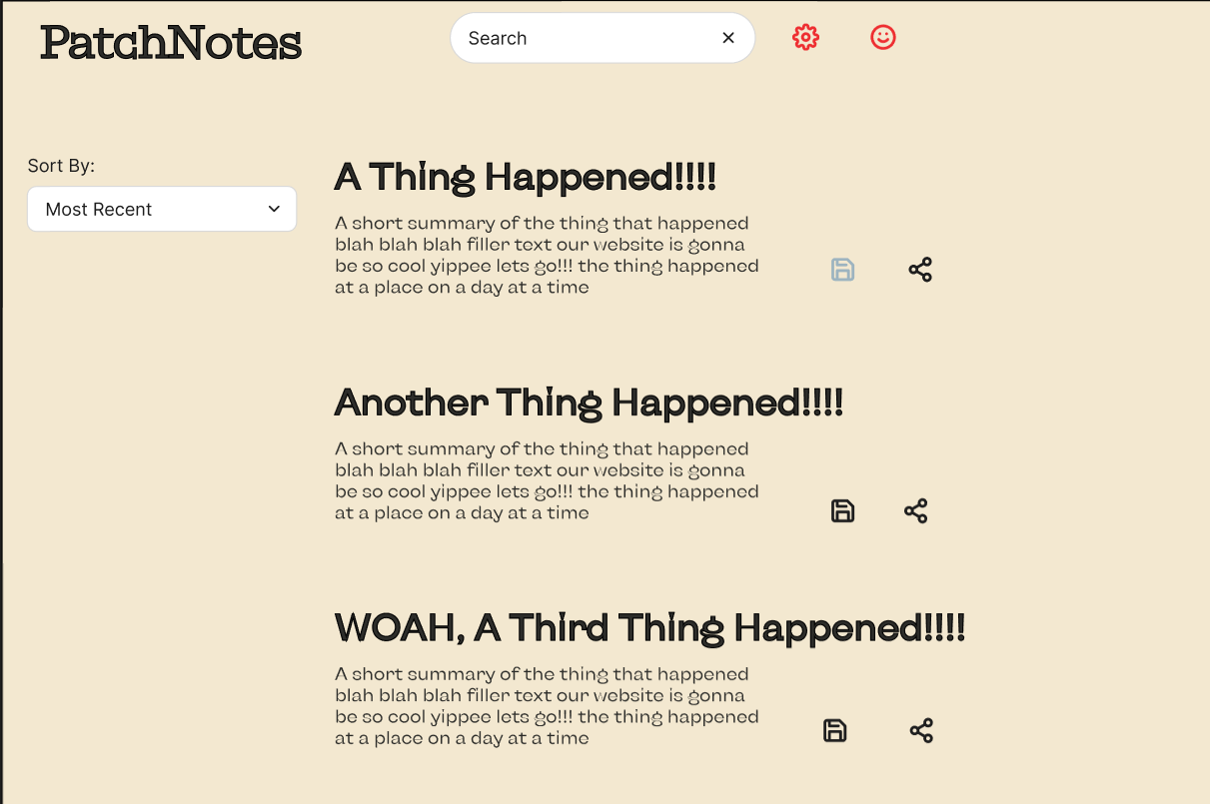
Sitemap & Wireframe

Slide 8
Video!!

